Slide 1
How to build an Industry Cost Profile (ICP) for a product in Singapore
Identify Data Sources for Financial and Manufacturing Information Related to Industry
Step 2
Obtain the Data for Manufacturing and Financial Information Related to Industry
Step 3
Use Financial and Manufacturing Information to Calculate Ratios for DM, DL, MOH, COGS, PBT, GSA & Other Expenses
Step 1

Slide 2
Identify Data Sources for Financial and Manufacturing Information Related to Industry
Step 1
Singapore Government manufacturing & financial statistics are found at:
 | Direct Material (DM)
 | Direct Labor (DL)
 | Manufacturing Overhead (MOH)
 | Cost of Goods Sold (COGS)
 | GSA & Other Expenses
 | Profit Before Tax (PBT)
 | Total Sales
singstat.gov.sg
Manufacturing data
Source: Department of Statistics Singapore
Financial data
Source: Department of Statistics Singapore
*You will use the data sources to express DM, DL, MOH, COGS, GSA & Other Expenses and PBT as ratios, in the form of percentages of Total Sales.
Note: Use financial reports of companies (Income Statement or Profit/Loss Account) as an additional source of Financial data

Slide 3
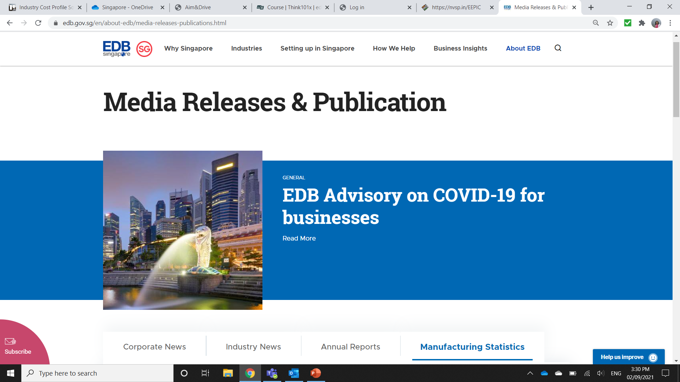
Obtain the Data for Manufacturing and Financial Information Related to Industry
Step 2
1. Go to:
2. Click on “Manufacturing Statistics”
https://www.edb.gov.sg/en/news-and-events/resources.html

Slide 4
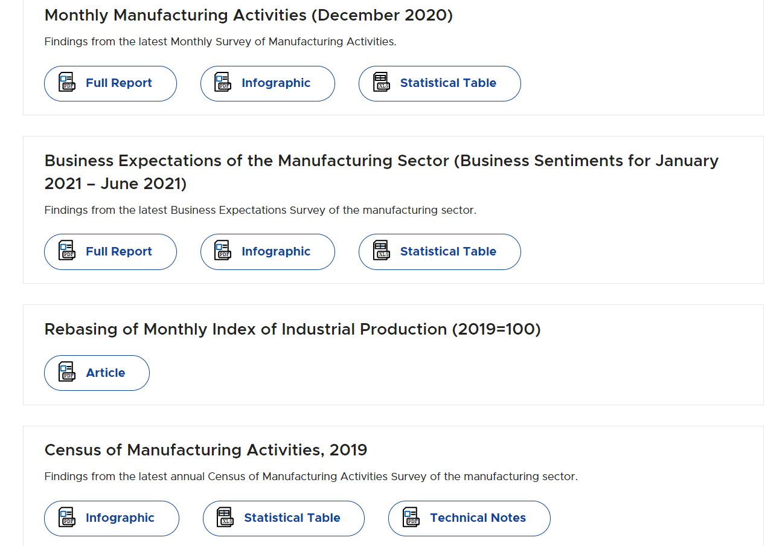
Obtain the Data for Manufacturing and Financial Information Related to Industry
Step 2
3. Scroll down to find ‘Census of Manufacturing Activities, 2019’
4. Download the excel file by clicking on “Statistical tables”.

Slide 5
Step 2
Obtain the Data for Manufacturing and Financial Information Related to Industry
Locate Industry of interest in Tables 11 & 13 of the PDF file.
For our Example it is “25- Fabricated Metal Products”
In Table 11, Record the following values:-
Sales
Materials
Remuneration

Slide 6
Obtain the Data for Manufacturing and Financial Information Related to Industry
Step 2
In Table 13, Record the following values:-
Repair and Servicing
Utilities
Transportation charges
Rent For Premises, Machinery & Transport Equipment
Professional Services
Advertising And Promotion
Work Given Out
Others

Slide 7
Obtain the Data for Manufacturing and Financial Information Related to Industry
Step 2
Use the USA “Annual Survey of Manufacturers” data to obtain Production Worker Annual Wages as a percentage of Annual Payroll
See the ICP procedure for USA for steps to locate values for:
Annual Payroll
Production Worker Annual Wages
ICP USA

Slide 8
Obtain the Data for Manufacturing and Financial Information Related to Industry
Step 2
For the “Other fabricated metal product manufacturing - NAICS 3329” :-
Annual Payroll - 14,999,160
Production and/or development and exploration workers annual wages - 8,885,214
Production Worker Annual Wages/ Annual Payroll is 59%

Slide 9
Use Financial and Manufacturing Information to Calculate Ratios
Step 3
In Singapore, follow 6 steps to find DM, DL,MOH,COGS, GSA & PBT
Step 1.Calculate Direct Labor using the Production worker annual wages to Annual Payroll ratio
from USA data.
Step 2. Calculate Direct Material as a percentage of Sales
1.
 | Remuneration | 1,416,257
 | Sales | 7,742,353
 | Production Worker Annual Wages/ Annual Payroll | 59%
 | Direct Labor | =0.59*(1,416,257/7,742,353)
 |  | = 10.79%
 | Materials | 4,221,165
 | Sales | ÷ 7,742,353
 | Direct Material | = 54.52%
2.
Note- 59% of Remuneration contributes to Direct Labor, remaining 41% is a part of GSA & Other Expenses

Slide 10
Use Financial and Manufacturing Information to Calculate Ratios
Step 3
Step: 3
3. Calculate MOH as a percentage of Sales using below formula.
Utilities, Rent & Other Operating Cost are divided equally between MOH & GSA and other expenses.
3.
 | Repair & Services | 103,934
 | Transportation Charges | + 74,802
 | Utilities | + 0.50*77,467
 | Rent for Premises, Machinery & Transport Equipment | + 0.50*118,284
 | Other Operating Cost | + 0.50*501,525
 | MOH | = 531874
 | Sales | ÷ 7,742,353
 | MOH | =6.87%
MOH= (Repair & Services + Transportation Charges +0.50( Utilities + Rent + Other Operating Cost ))/Sales

Slide 11
Use Financial and Manufacturing Information to Calculate Ratios
Step 3
Step: 4
4. Calculate Cost of Goods Sold (COGS) % as follows:
 | DL | 10.79%
 | DM | + 54.52%
 | MOH | + 6.87%
 | COGS | 72.18%
4.
COGS = DL+ DM + MOH

Slide 12
Use Financial and Manufacturing Information to Calculate Ratios
Step 3
Step: 5
GSA & Other Expenses as a percentage of Sales
Express PBT as a percentage of Total Sales
 | Professional Services | 7,736
 | Advertising & Promotion | + 20219
 | Work Given Out | + 572,238
 | Remuneration | + 0.41*1,416,257
 | Utilities | + 0.50*77,467
 | Rent for Premises, Machinery & Transport Equipment | + 0.50*118,284
 | Other Operating Cost | + 0.50*510,525
 | GSA & other Expenses | = 1,533,996
 | Sales | ÷ 7,742,353
 | GSA & Other Expenses | = 19.81%
5.
GSA & Other Expense= (Professional Services, Advertising & Promotion + Work Given Out +0.41*Remmuneration+0.50(Utilities + Rent + Other Operating Cost ))/Sales

Slide 13
Use Financial and Manufacturing Information to Calculate Ratios
Step 3
Step: 6
6. Calculate Profit Before Tax (PBT) as follows:
 | Total | 100%
 | less COGS | 72.18%
 | less GSA & other Expenses | 19.81%
 | PBT | 8.01%
6.
PBT= 100-COGS-GSA & Other Expenses

Slide 14
Present all your calculated ratios in the cost breakdown format
Industry cost profile for “Fabricated Metal Products”
 | Direct Material (DM) | 54.52%
 | Direct Labor (DL) | 10.79%
 | Manufacturing Overhead (MOH) | 6.87%
 | Cost of Goods Sold (COGS) | 72.18%
 | GSA & Other Expenses | 19.81%
 | Profit Before Tax (PBT) | 8.01%
 | Total Sales | 100.00%
Ratios calculated from Department of Statistics Singapore
Ratios calculated from Department of Statistics Singapore

Slide 15
References and summary of ICP calculations
Cost Element | % of Sales | Calculation | Order
DM | 54.52% | =B/A | 1
DL | 10.79% | =(C*L)/A | 2
MOH | 6.87% | = D+F+0.50(E+G+K) | 3
COGS | 72.18% | = DM+DL+MOH | 4
GSA | 19.81% | = H+I+K+0.41*C+0.50(E+G+K) | 5
PBT | 8.01% | = 100-COGS-GSA | 6
TOTAL | 100.00%
 | Data Point | Sector | Value | Source
A | Sales | Fabricated Metal Products | 7,742,353 | Department of Statistics Singapore
B | Materials | Fabricated Metal Products | 4,221,165 | Department of Statistics Singapore
C | Remuneration | Fabricated Metal Products | 1,416,257 | Department of Statistics Singapore
D | Repair & Servicing | Fabricated Metal Products | 103,934 | Department of Statistics Singapore
E | Utilities | Fabricated Metal Products | 77,467 | Department of Statistics Singapore
F | Transportation charges | Fabricated Metal Products | 74,802 | Department of Statistics Singapore
G | Rent for Premises, Machinery & Transport Equipment | Fabricated Metal Products | 118,284 | Department of Statistics Singapore
H | Professional Services | Fabricated Metal Products | 7,736 | Department of Statistics Singapore
I | Advertising & promotions | Fabricated Metal Products | 20,219 | Department of Statistics Singapore
J | Work Given Out | Fabricated Metal Products | 572,238 | Department of Statistics Singapore
K | Others ( Operating Cost) | Fabricated Metal Products | 510,525 | Department of Statistics Singapore
L | Production worker wages/Annual Payroll | Other fabricated metal product manufacturing - NAICS 3329 | 59% | US Economic Census Annual Survey Of Manufacturers 2018

